Slide 1
Thumbs Up or Thumb Down on Indian Financial News Headlines
We have performed sentiment analysis on Indian financial news headlines.
We opted for unsupervised approach which is based on Turney’s algorithm, primarily due to lack of labelled dataset in this domain.
By
Aman Shah - 18BCP004
Anurag Pal - 18BCP007
Sagar Sinha- 18BCP094

Slide 2
LITERATURE SURVEY
Research Paper 1:
Title : Thumbs Up or Thumbs Down? Semantic Orientation Applied to Unsupervised Classification of Reviews
Link: https://www.aclweb.org/anthology/P02-1053.pdf
Author: Peter D. Turney
Dataset: 410 reviews of 4 different domains i.e. automobiles, banks, movies and travel destinations from Epinions.
Methodology: The algorithm has three steps: (1) extract phrases containing adjectives or adverbs, (2) estimate the semantic orientation of each phrase using PMI-IR, and (3) classify the review based on the average semantic orientation of the phrases.

Slide 3
LITERATURE SURVEY
Accuracy
Domain of review | Accuracy
Automobiles | 84.00 %
Banks | 80.00 %
Movies | 65.83 %
Travel Destinations | 70.53 %
Average accuracy | 74.39%
:

Slide 4
LITERATURE SURVEY
Research Paper 2:
Title: Sentiment analysis of financial news using unsupervised approach
Link: https://www.sciencedirect.com/science/article/pii/S1877050920307912
Author: Anita Yadav, C K Jha, Aditi Sharan, Vikrant Vaish
Dataset: Data collected from various online sources for TCS company and manually labelled by domain experts.
Methodology: Step1 - Extracting phrases using three different approaches namely 1. Turney’s pattern, 2. POS using seed set(Hybrid), 3. Noun-verb combinations.
Step 2 - Finding PMI of phrases with sentiment indicators.
Step 3 - Calculating average SO of documents.
Accuracy: The accuracy is found out to be in the following order
Noun-verb approach > Hybrid approach > Turney’s approach

Slide 5


Dataset
Link https://github.com/sinhasagar507/market-sentiment-analysis/tree/master/data/processed
Name Indian financial news articles (2003-2020)
Description The dataset contains headlines of Indian financial news and some description about the news. It contains 4 columns namely Unique ID, Date, Title, Description.

Slide 6
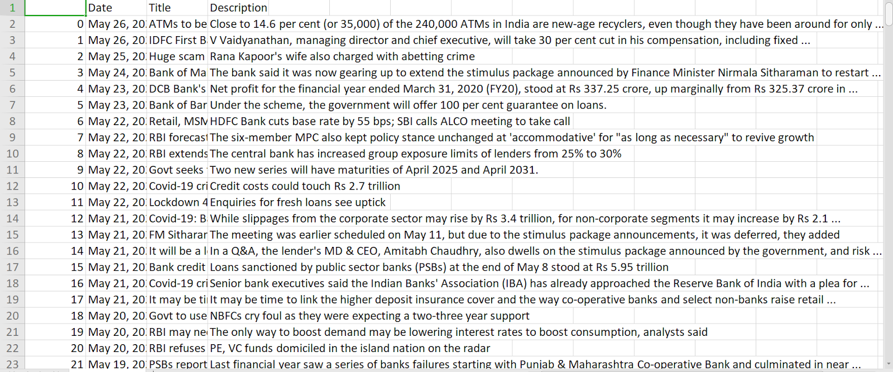
An Instance of our dataset

Slide 7
Approach
Some key features of our processed dataset after being labelled via Turney’s algorithm.
We only have binary labels(0/1) in our dataset.
Neutral/Negative(“0”) label was underrepresented whereas sentences evoking positive sentiment(“1”) were excess in number, hence signifying an imbalanced dataset.

Slide 8
So what’s the issue?
On training, the algorithm will heavily bias itself towards the positive label, thereby leading to overfitting, and hence will perform poorly on validation and test sets.
And that’s what we observed. The algorithm gave a poor F1-score for labels marked “0”.

Slide 9

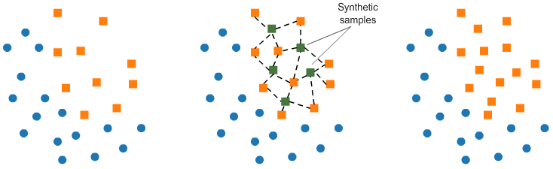
Improvement
To curb the above problem, we applied different synthetic sampling techniques such as Undersampling, Oversampling and SmoteTOMEK(Synthetic Minority Oversampling technique). We applied all of them and eventually found out that SmoteTOMEK worked out the best for us.
SmoteTOMEK - a representation of “SMOTE” synthetic samples as an oversampling technique and “TOMEK” links as an Undersampling technique.

Slide 10
Machine Learning Modelling and Results
We extracted several features for our final model such as no. of words, count of different phrases, mean-word-length, etc. and concatenated them with our TF-IDF numerical features of text. These features have been used in training.
We applied relevant Machine Learning algorithms using Stratified K-Fold cross-validation(useful for imbalanced datasets) and performed hyperparameter tuning, on some algorithms which have been proven to perform on text-based datasets, such as Naive Bayes, Random Forest Classifier, ANN and RNN. Of these we achieved the best results on Random Forest Classifier with a test-set F1-score of 0.81 and were also able to improve the f1-score for neutral/negative label.
0.8075
precision recall f1-score support
Label0 0.55 0.13 0.22 394
Label1 0.82 0.97 0.89 1606
accuracy 0.81 2000
macro avg 0.68 0.55 0.55 2000
weighted avg 0.77 0.81 0.76 2000
Results

Slide 11
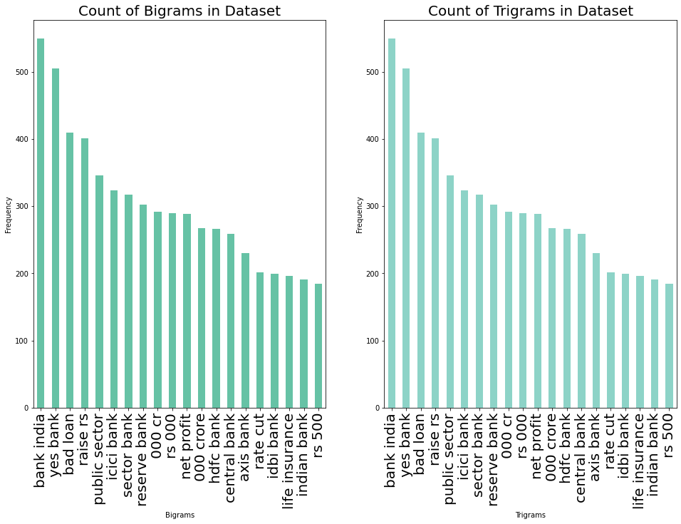
Visualizations.
Top-10 N-Grams:

Slide 12
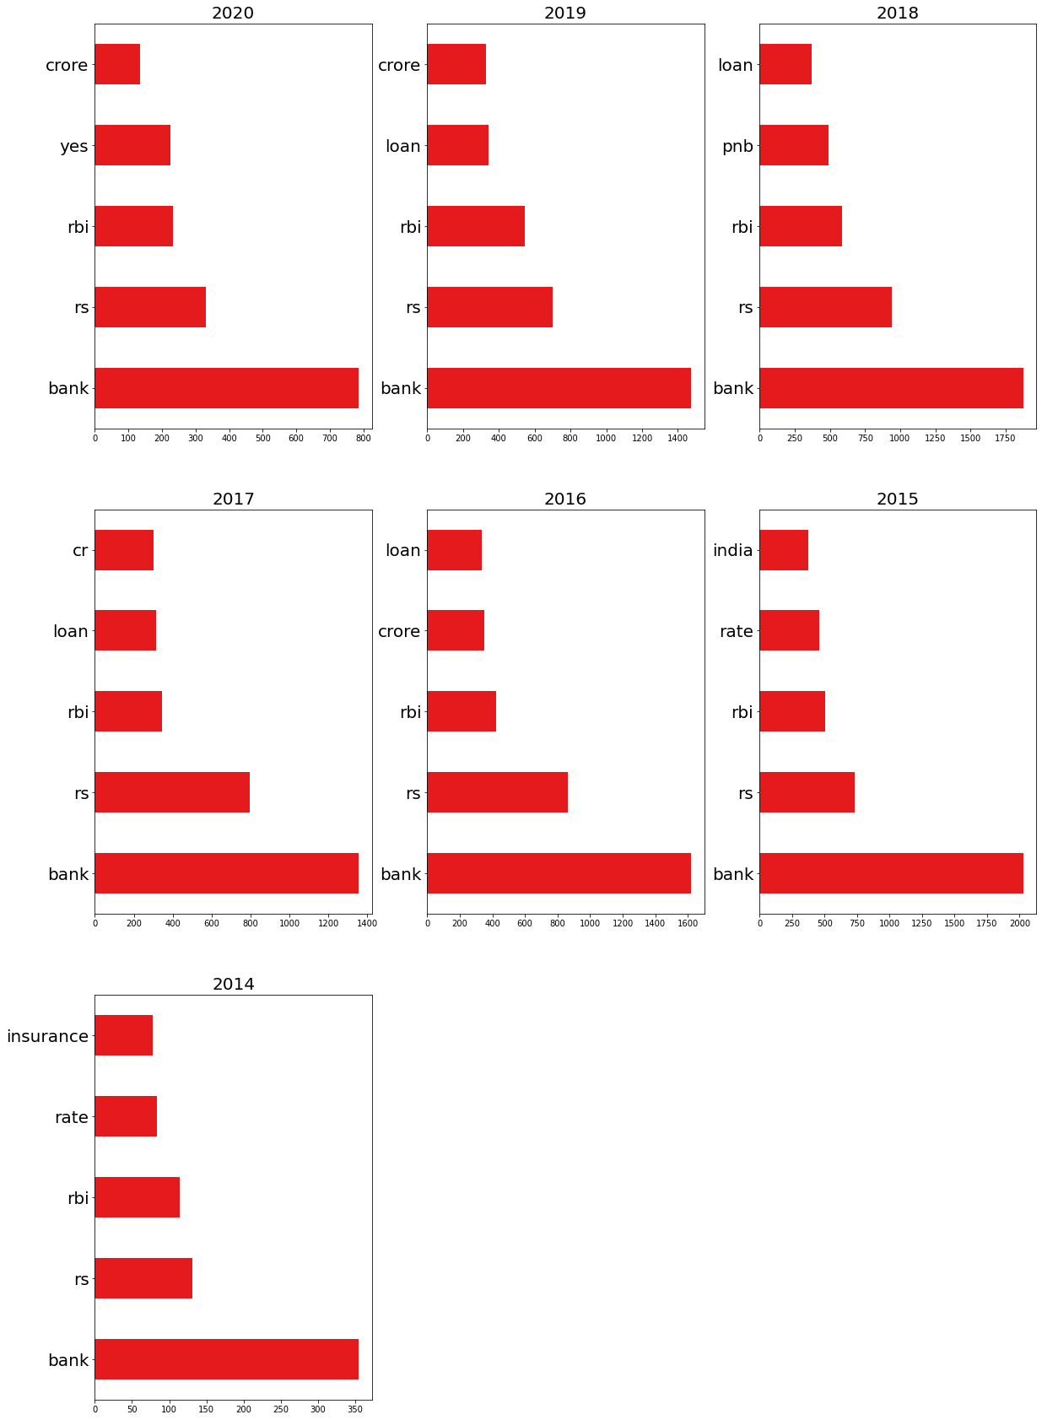
Visualizations.
Top-10 N-Grams:
**Year-Wise breakdown of the topmost-5 N-grams**

Slide 13
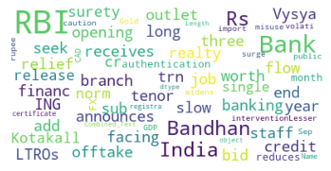
Word-Cloud(example):

Slide 14
Differences in our existing work and those available in market:
We have extracted more tag-based features by extracting more rules, in addition to the ones specified by Turney, such as noun-verb, verb-noun, adjective-noun approaches, etc.
In Turney's original paper, keywords "excellent" and "poor" were used to capture positive semantic orientation and negative semantic orientation respectively, we did some analysis, and found out two words, namely "boost" and
"decline", which suited our use-case.
Most of the work in sentiment analysis in the domain of our choice consists of supervised learning approaches,
wherein there exist pre-labelled datasets by domain experts, and we used an unsupervised approach.
d. In original Turney’s work, the no. of hits are calculated by issuing queries to a search engine(hence the IR in PMI-IR) noting the number of hits(matching documents). The author used AltaVista engine since it has a NEAR operator. Since the search engine has deprecated, we consider our corpus as our database from which we extract frequency counts of phrases. Using regular expressions, we implemented a NEAR operator which searches for the occurrence of phrases in the vicinity of keywords.

Slide 15
Future proposal/Work
We intend to extend our knowledge gained through this work to try out more approaches in unsupervised sentiment analysis
As an extension of this work, we aim to build a realtime sarcasm detector(which is a more challenging task) on news tweets during the pandemic.

Slide 16
Thank You!
By
Aman Shah - 18BCP004
Anurag Pal - 18BCP007
Sagar Sinha- 18BCP094

